Slide 1

Marine Insurance Flood Insurance Broker Portal
Secure & simplest web app streamlines flood insurance management for brokers.

Slide 2
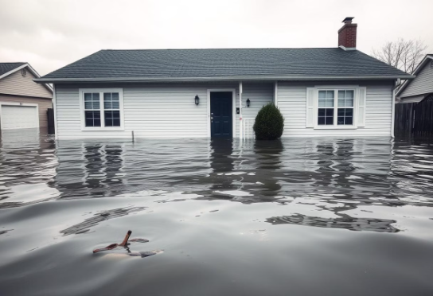


Flood Insurance & Its Importance
What is Flood Insurance?
Why Need Flood Insurance?
Who Needs Flood Insurance?
Financial protection against property damage caused by flooding.
Increasing extreme weather and flood risks.
Individuals living in flood-prone zones.
Businesses vulnerable to flood damage.
Not typically covered by standard homeowners insurance.
Helps mitigate financial impact of floods.
Property owners requiring mortgage compliance.
Enables faster repairs and peace of mind.
Specifically designed policy for flood risks.
Often required by mortgage or lending institutions in flood-prone areas.
Anyone seeking asset protection from flood risks.

Slide 3
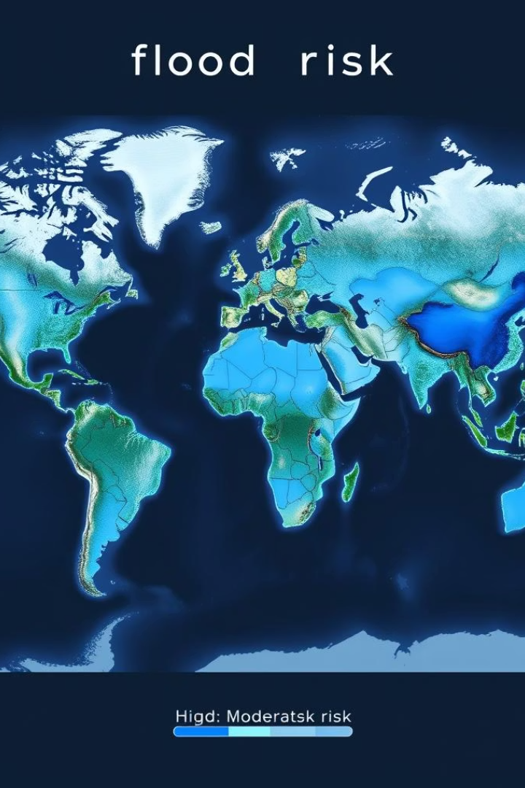
Scope and Objective
Scope of Marine
Objective of Marine
Centralized platform for flood insurance management for brokers.
Enhance broker efficiency through automation and data integration.
Integration with real-time flood risk data to support informed decisions.
Provide a secure and user-friendly tool for flood insurance solutions.
Streamlines policy quoting, issuance, and compliance with regulations.
Improve customer satisfaction with timely and accurate service delivery.

Slide 4





Frontend Architecture: Angular 19
Component-Based Design
Multi-Step Image Based Forms
Reusable UI elements enhance efficiency and maintainability.
Robust data validation ensures quality user input handling.
Real-Time Progress Bar
Modern Theme UI
Light theme UI fostering the trust between broker and portal
Providing the current updates about the quote form filling.

Slide 5

Backend Architecture:
ASP.NET Web API
RESTful Services
Service Oriented Architecture
Provides secure, scalable data access and manipulation.
Controller Layer separating business logic from User, dividing an application into discrete services.
Layered Architecture
Testing and Validation
Use of DTO's to organise the application, each with a specific role and responsibility.
Unit Testing of the Rating API ensuring accuracy of calculated premium.

Slide 6

Database Design:
SQL Server & Entity Framework
Normalized Schema
Entity Framework ORM
Ensures data integrity and reduces redundancy by organizing data into separate tables such as User and Quotes.
Facilitates database interaction with a code-first approach, simplifying development and supporting migrations.

Slide 7
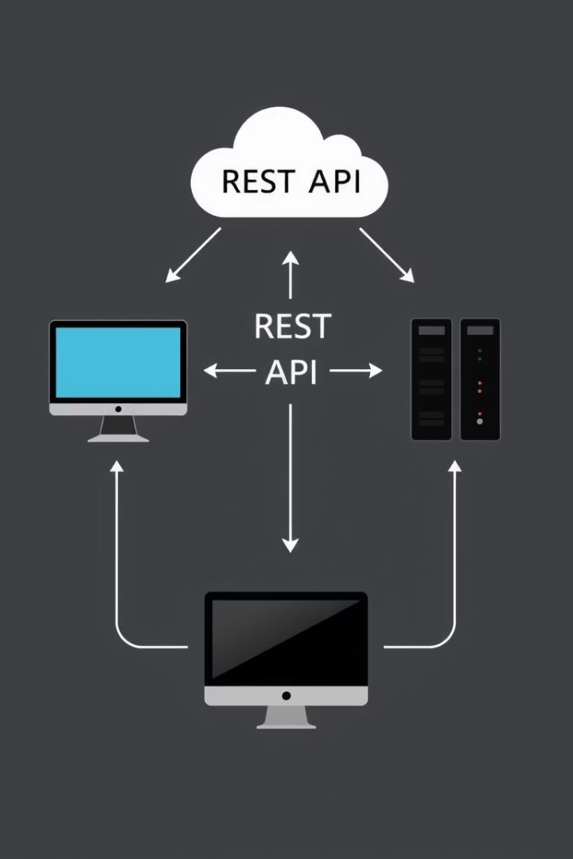
REST API Communication
Standardized JSON Data
Lightweight format for efficient data exchange.
HTTP Methods
GET, POST, PUT, DELETE enable full CRUD operations.
Error Handling
Robust reporting ensures smooth user experience.

Slide 8

Technical & Functional Features
Technical Features
Functional Features
Robust backend with ASP.NET Web API ensuring secure data access
Multi-step image-based forms with robust validation
Entity Framework for efficient database operations and code-first migration
Real-time progress bar to guide users through quoting process
RESTful services supporting standardized JSON communication
Streamlined policy quoting, issuance, and compliance checks
Responsive frontend built with Angular 19 and reusable components
Secure broker portal with user authentication and role management
Real-time flood risk data integration for precise risk assessment
Automated premium calculation via rating engine

Slide 9



Rating Engine: Premium Calculation
Rating API Variability
2
Varies based on personal property, deductible, and other individual factors.
Risk Factors
1
Includes flood zone, property details, and coverage options.
Real-Time Quotes
3
Instant premium estimates for brokers on demand.

Slide 10





Key Features and Benefits
Quote Generation
Policy Management
Client Management
Reporting & Analytics
Accurate, quick flood insurance quotes for clients.
Centralized and efficient administration of policies.
Comprehensive client data storage and access.
Data-driven insights to track performance.

Slide 11

Innovation and Creativity
Risk Calculator
Client Finding Assistance For Broker
Utilizes advanced algorithms to provide accurate flood risk assessments instantly.
Helps brokers identify and connect with potential clients efficiently.
Analytical and Real-Time Dashboard
Real-Time Status Tracking by Email Notification
Displays up-to-date insights and performance metrics for informed decisions.
Keeps users informed about quote progress and updates via timely email alerts.
PDF Export Helping in Sharing
Enables easy export of quotes and reports for client communication and records.

Slide 12
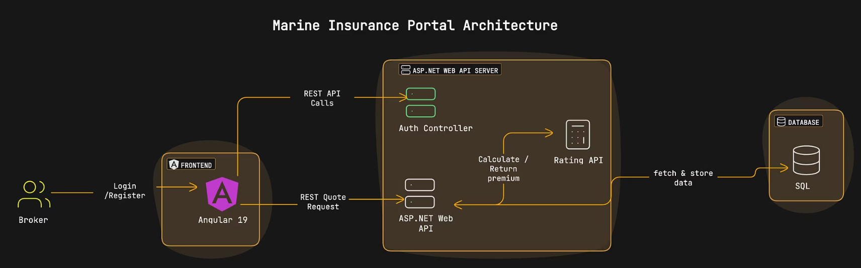
Marine Insurance Portal Workflow
This flow chart illustrates the complete workflow process for the Flood Insurance Broker Portal, detailing the user journey and system interactions from quote generation to policy management.

Slide 13

Future Enhancements
1
AI-Powered Risk Assessment
Using AI to enhance flood risk predictions.
2
Automated Claims Processing
Speed up claim handling with automation.
3
Mobile App Integration
Access portal features on mobile devices.
4
Enhanced Reporting Dashboards
Improved visual insights for brokers and managers.
5
Expanded Data Integrations
Include new external data for richer analytics.

Slide 14

Thank You
Thank you for your time and interest in the Marine Insurance .
MUKUND BAJPAI

